Slide 1


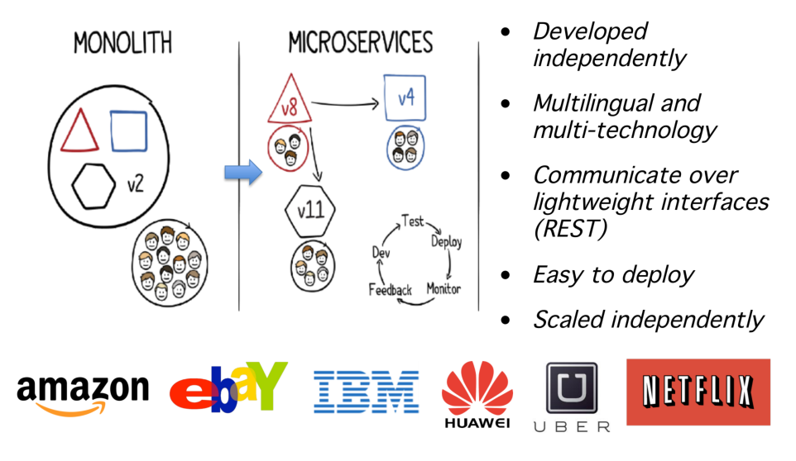
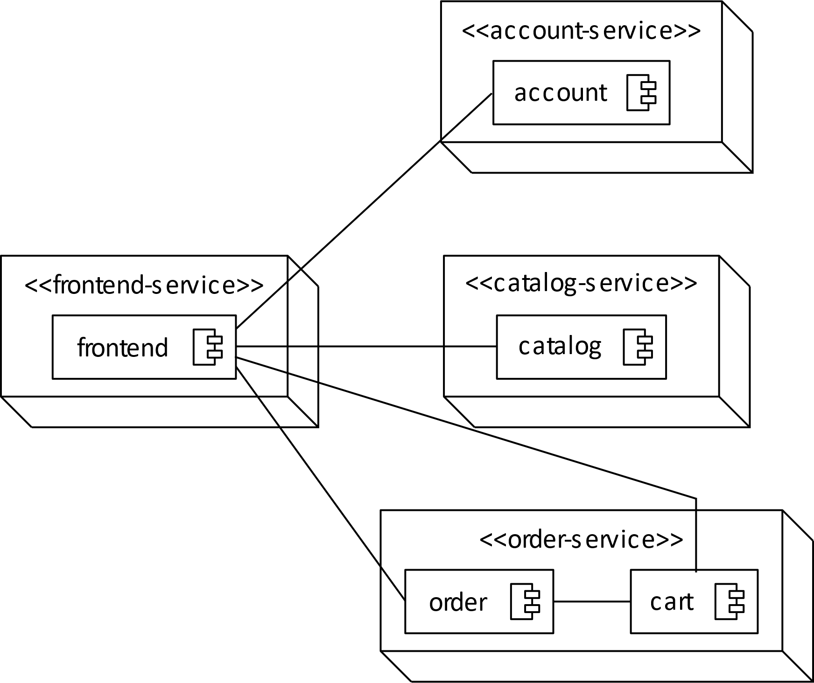
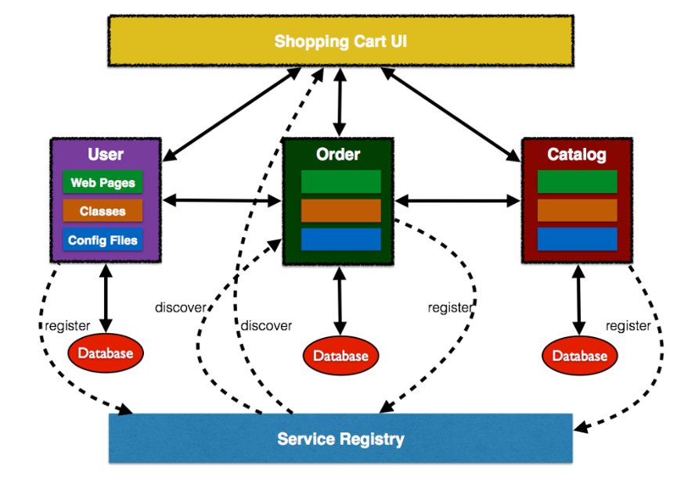
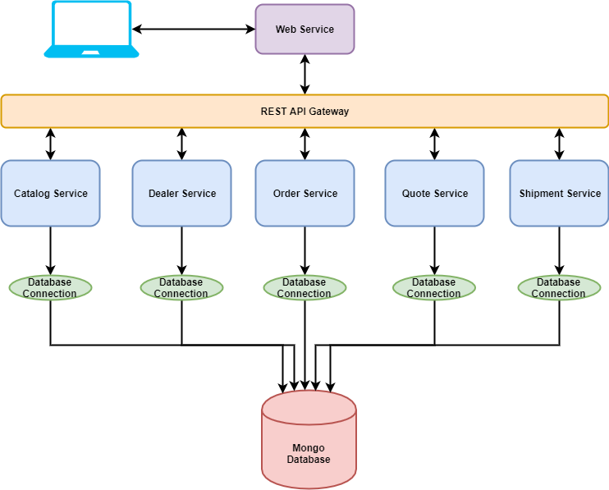
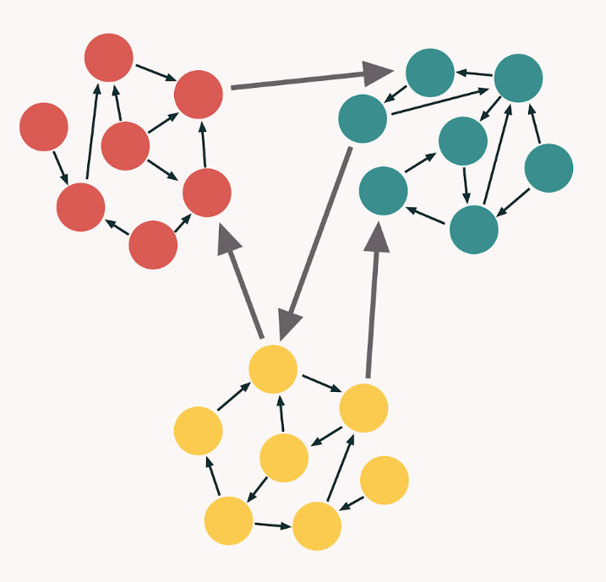
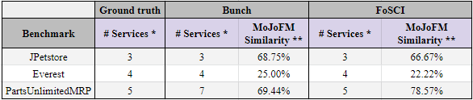
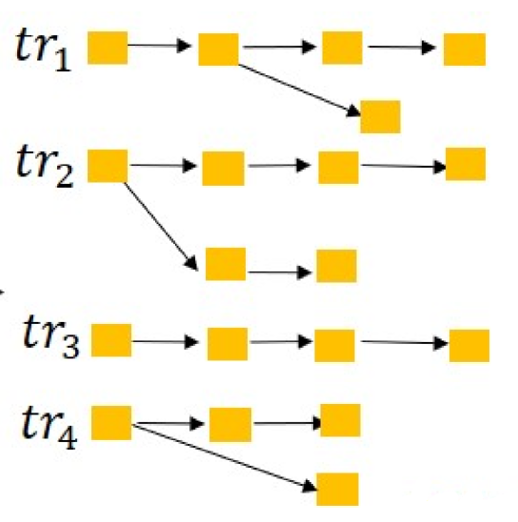
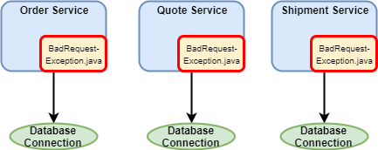

A Comparative Analysis of Microservice Extraction Techniques
Lisa Kirby¹, Julia Rubin¹, Ao Tang¹, Will Zhang¹, Yee-Kang Chang², Cindy High³
¹ The University of British Columbia, Vancouver, Canada
² IBM, Ontario, Canada ³ IBM, New York, United States
Contact: lisakirby@alumni.ubc.ca, mjulia@ece.ubc.ca
What are microservices?
Manually splitting applications into microservices requires time, effort, & architectural expertise.
Can we automate this process?
Problem
Independently deployable + scalable components
Multilingual & multi-technology
Communicate over lightweight interfaces
Most prominent techniques
Subjects: Apps with both monolithic and microservice-based versions
Static-Analysis:
Bunch Hill Climbing
(Mitchell et al.)
JPetstore (Java EE)
github.com/mybatis/jpetstore6
Everest (Java EE)
github.com/arun-gupta/microservices
PartsUnlimitedMRP (Java & C#)
github.com/microsoft/PartsUnlimitedMRP
Core Design Principle:
High Cohesion, Low Coupling
Results
Dynamic-Analysis:
FoSCI
(Jin et al.)
* Does not include frontend ** MoJoFM: Calculates class-level distance function between two architectures
Core Design Principle:
Single Responsibility
Why is the similarity so low?
Lessons learned
Intentional code duplication in ground truth microservices (exceptions, database connections, factories)
Addition / modification of classes to support ground truth microservices (e.g. to handle communication)
Small benchmarks → small errors are “costly”
“Legitimate” exceptions to the high cohesion / low coupling rule are difficult to handle
Microservices often rely on frameworks, e.g., for communication. Supporting code is not available in the monoliths and needs to be generated from scratch
Decompositions focused around architectural principles can miss key considerations related to performance, deployment constraints, etc.
Notes:
TEMPLATE IS FULLY CUSTOMIZABLE. BOXES AND PLACEHOLDERS CAN BE REMOVED. COLOURS CAN BE CHANGED.
UBC LOGO MUST REMAIN TOP LEFT. UBC BRANDING BAR AT THE BOTTOM CAN BE DELETED IF DESIRED.

